Slide 1
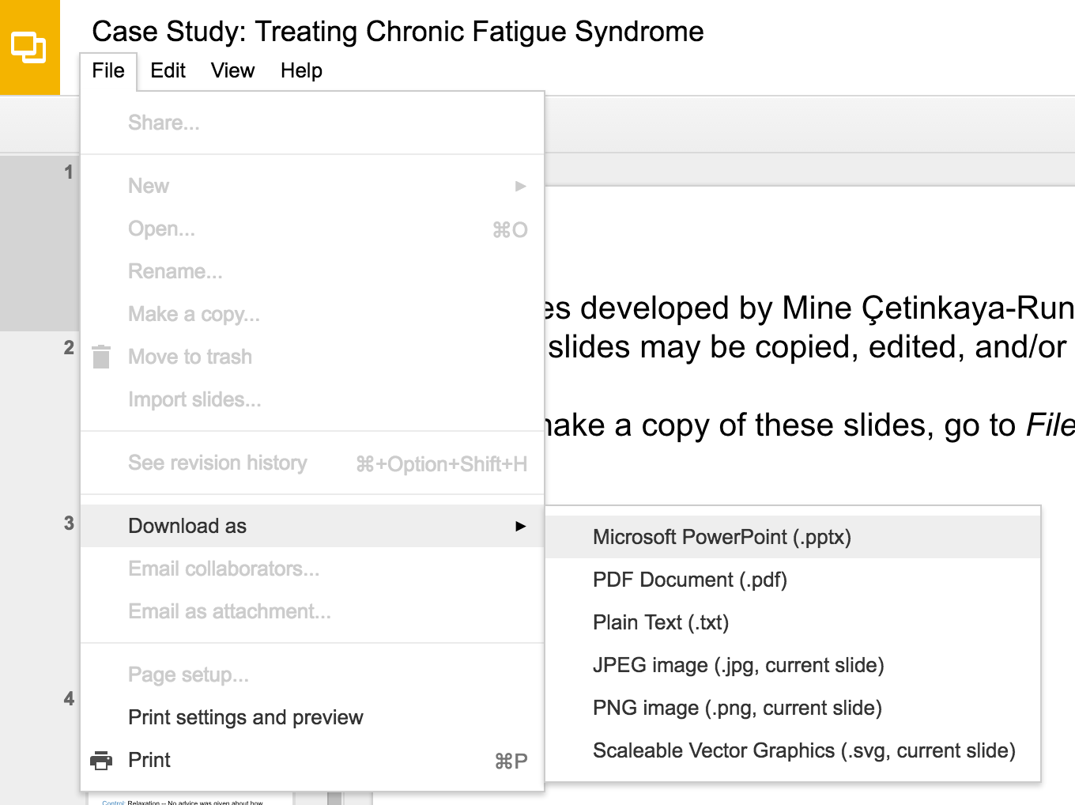
Slides developed by Mine Çetinkaya-Rundel of OpenIntro
Translated from LaTeX to Google Slides by Curry W. Hilton of OpenIntro.
The slides may be copied, edited, and/or shared via the CC BY-SA license
To make a copy of these slides, go to File > Download as > [option], as shown below. Or if you are logged into a Google account, you can choose Make a copy... to create your own version in Google Drive.

Slide 2
Sampling from a
Small Population

Slide 3
Sampling with replacement
When sampling with replacement, you put back what you just drew.
Imagine you have a bag with 5 red, 3 blue and 2 orange chips in it. What is the probability that the first chip you draw is blue? 5 O, 3 O, 2 O

Slide 4

Sampling with replacement
When sampling with replacement, you put back what you just drew.
Imagine you have a bag with 5 red, 3 blue and 2 orange chips in it. What is the probability that the first chip you draw is blue? 5 O, 3 O, 2 O

Slide 5
Sampling with replacement
When sampling with replacement, you put back what you just drew.
Imagine you have a bag with 5 red, 3 blue and 2 orange chips in it. What is the probability that the first chip you draw is blue? 5 O, 3 O, 2 O
Suppose you did indeed pull a blue chip in the first draw. If drawing with replacement, what is the probability of drawing a blue chip in the second draw?

Slide 6
Sampling with replacement
When sampling with replacement, you put back what you just drew.
Imagine you have a bag with 5 red, 3 blue and 2 orange chips in it. What is the probability that the first chip you draw is blue? 5 O, 3 O, 2 O
Suppose you did indeed pull a blue chip in the first draw. If drawing with replacement, what is the probability of drawing a blue chip in the second draw?
1st Draw - 5 O, 3 O, 2 O

Slide 7
Sampling with replacement
When sampling with replacement, you put back what you just drew.
Imagine you have a bag with 5 red, 3 blue and 2 orange chips in it. What is the probability that the first chip you draw is blue? 5 O, 3 O, 2 O
Suppose you did indeed pull a blue chip in the first draw. If drawing with replacement, what is the probability of drawing a blue chip in the second draw?
1st Draw - 5 O, 3 O, 2 O
2nd Draw - 5 O, 3 O, 2 O

Slide 8
Sampling with replacement
When sampling with replacement, you put back what you just drew.
Imagine you have a bag with 5 red, 3 blue and 2 orange chips in it. What is the probability that the first chip you draw is blue? 5 O, 3 O, 2 O
Suppose you did indeed pull a blue chip in the first draw. If drawing with replacement, what is the probability of drawing a blue chip in the second draw?
1st Draw - 5 O, 3 O, 2 O
2nd Draw - 5 O, 3 O, 2 O
P(2nd chip B | 1st chip B) = 3 / 10 = 0.3

Slide 9
Sampling with replacement (cont.)
Suppose you actually pulled an orange chip in the first draw. If drawing with replacement, what is the probability of drawing a blue chip in the second draw?

Slide 10
Sampling with replacement (cont.)
Suppose you actually pulled an orange chip in the first draw. If drawing with replacement, what is the probability of drawing a blue chip in the second draw?
1st Draw - 5 O, 3 O, 2 O

Slide 11
Sampling with replacement (cont.)
Suppose you actually pulled an orange chip in the first draw. If drawing with replacement, what is the probability of drawing a blue chip in the second draw?
1st Draw - 5 O, 3 O, 2 O
2nd Draw - 5 O, 3 O, 2 O

Slide 12
Sampling with replacement (cont.)
Suppose you actually pulled an orange chip in the first draw. If drawing with replacement, what is the probability of drawing a blue chip in the second draw?
1st Draw - 5 O, 3 O, 2 O
2nd Draw - 5 O, 3 O, 2 O
P(2nd chip B | 1st chip O) = 3 / 10 = 0.3

Slide 13
Sampling with replacement (cont.)
Suppose you actually pulled an orange chip in the first draw. If drawing with replacement, what is the probability of drawing a blue chip in the second draw?
1st Draw - 5 O, 3 O, 2 O
2nd Draw - 5 O, 3 O, 2 O
P(2nd chip B | 1st chip O) = 3 / 10 = 0.3
If drawing with replacement, what is the probability of drawing two blue chips in a row?

Slide 14
Sampling with replacement (cont.)
Suppose you actually pulled an orange chip in the first draw. If drawing with replacement, what is the probability of drawing a blue chip in the second draw?
1st Draw - 5 O, 3 O, 2 O
2nd Draw - 5 O, 3 O, 2 O
P(2nd chip B | 1st chip O) = 3 / 10 = 0.3
If drawing with replacement, what is the probability of drawing two blue chips in a row?
1st Draw - 5 O, 3 O, 2 O
2nd Draw - 5 O, 3 O, 2 O

Slide 15
Sampling with replacement (cont.)
Suppose you actually pulled an orange chip in the first draw. If drawing with replacement, what is the probability of drawing a blue chip in the second draw?
1st Draw - 5 O, 3 O, 2 O
2nd Draw - 5 O, 3 O, 2 O
P(2nd chip B | 1st chip O) = 3 / 10 = 0.3
If drawing with replacement, what is the probability of drawing two blue chips in a row?
1st Draw - 5 O, 3 O, 2 O
2nd Draw - 5 O, 3 O, 2 O
P(1st chip B) x P(2nd chip B | 1st chip B) = 0.3 x 0.3 = 0.09

Slide 16
Sampling with replacement (cont.)
When drawing with replacement, probability of the second chip being blue does not depend on the color of the first chip since whatever we draw in the first draw gets put back in the bag.
Prob(B | B) = Prob(B | O)
In addition, this probability is equal to the probability of drawing a blue chip in the first draw, since the composition of the bag never changes when sampling with replacement.
Prob(B | B) = Prob(B)
When drawing with replacement, draws are independent.

Slide 17
Sampling without replacement
When drawing without replacement you do not put back what you just drew.

Slide 18
Sampling without replacement
When drawing without replacement you do not put back what you just drew.
Suppose you pulled a blue chip in the first draw. If drawing without replacement, what is the probability of drawing a blue chip in the second draw?

Slide 19
Sampling without replacement
When drawing without replacement you do not put back what you just drew.
Suppose you pulled a blue chip in the first draw. If drawing without replacement, what is the probability of drawing a blue chip in the second draw?
1st Draw - 5 O, 3 O, 2 O

Slide 20
Sampling without replacement
When drawing without replacement you do not put back what you just drew.
Suppose you pulled a blue chip in the first draw. If drawing without replacement, what is the probability of drawing a blue chip in the second draw?
1st Draw - 5 O, 3 O, 2 O
2nd Draw - 5 O, 2 O, 2 O

Slide 21
Sampling without replacement
When drawing without replacement you do not put back what you just drew.
Suppose you pulled a blue chip in the first draw. If drawing without replacement, what is the probability of drawing a blue chip in the second draw?
1st Draw - 5 O, 3 O, 2 O
2nd Draw - 5 O, 2 O, 2 O
P(2nd chip B | 1st chip B) = 2 / 9 = 0.22

Slide 22
Sampling without replacement
When drawing without replacement you do not put back what you just drew.
Suppose you pulled a blue chip in the first draw. If drawing without replacement, what is the probability of drawing a blue chip in the second draw?
1st Draw - 5 O, 3 O, 2 O
2nd Draw - 5 O, 2 O, 2 O
P(2nd chip B | 1st chip B) = 2 / 9 = 0.22
If drawing without replacement, what is the probability of drawing two blue chips in a row?

Slide 23
Sampling without replacement
When drawing without replacement you do not put back what you just drew.
Suppose you pulled a blue chip in the first draw. If drawing without replacement, what is the probability of drawing a blue chip in the second draw?
1st Draw - 5 O, 3 O, 2 O
2nd Draw - 5 O, 2 O, 2 O
P(2nd chip B | 1st chip B) = 2 / 9 = 0.22
If drawing without replacement, what is the probability of drawing two blue chips in a row?
1st Draw - 5 O, 3 O, 2 O
2nd Draw - 5 O, 2 O, 2 O

Slide 24
Sampling without replacement
When drawing without replacement you do not put back what you just drew.
Suppose you pulled a blue chip in the first draw. If drawing without replacement, what is the probability of drawing a blue chip in the second draw?
1st Draw - 5 O, 3 O, 2 O
2nd Draw - 5 O, 2 O, 2 O
P(2nd chip B | 1st chip B) = 2 / 9 = 0.22
If drawing without replacement, what is the probability of drawing two blue chips in a row?
1st Draw - 5 O, 3 O, 2 O
2nd Draw - 5 O, 2 O, 2 O
P(1st chip B) x P(2nd chip B | 1st chip B) = 0.3 x 0.22 = 0.066

Slide 25
Sampling without replacement (cont.)
When drawing without replacement, the probability of the second chip being blue given the first was blue is not equal to the probability of drawing a blue chip in the first draw since the composition of the bag changes with the outcome of the first draw.
Prob(B | B) ≠ Prob(B)

Slide 26
Sampling without replacement (cont.)
When drawing without replacement, the probability of the second chip being blue given the first was blue is not equal to the probability of drawing a blue chip in the first draw since the composition of the bag changes with the outcome of the first draw.
Prob(B | B) ≠ Prob(B)
When drawing without replacement, draws are not independent.

Slide 27
Sampling without replacement (cont.)
When drawing without replacement, the probability of the second chip being blue given the first was blue is not equal to the probability of drawing a blue chip in the first draw since the composition of the bag changes with the outcome of the first draw.
Prob(B | B) ≠ Prob(B)
When drawing without replacement, draws are not independent.
This is especially important to take note of when the sample sizes are small. If we were dealing with, say, 10,000 chips in a (giant) bag, taking out one chip of any color would not have as big an impact on the probabilities in the second draw.

Slide 28
Practice
In most card games cards are dealt without replacement. What is the probability of being dealt an ace and then a 3? Choose the closest answer.
(a) 0.0045
(b) 0.0059
(c) 0.0060
(d) 0.1553

Slide 29
Practice
In most card games cards are dealt without replacement. What is the probability of being dealt an ace and then a 3? Choose the closest answer.
(a) 0.0045
(b) 0.0059
(c) 0.0060
(d) 0.1553
P(ace, then 3) = (4 / 52) x (4 / 51) ~ 0.0060

Slide 30
Find more resources at openintro.org/os, including
Slides
Videos
Statistical Software Labs
Discussion Forums (free support for students and teachers)
Learning Objectives
Teachers only content is also available for Verified Teachers, including
Exercise solutions
Sample exams
Ability to request a free desk copy for a course
Statistics Teachers email group
Questions? Contact us.

